Slide 1
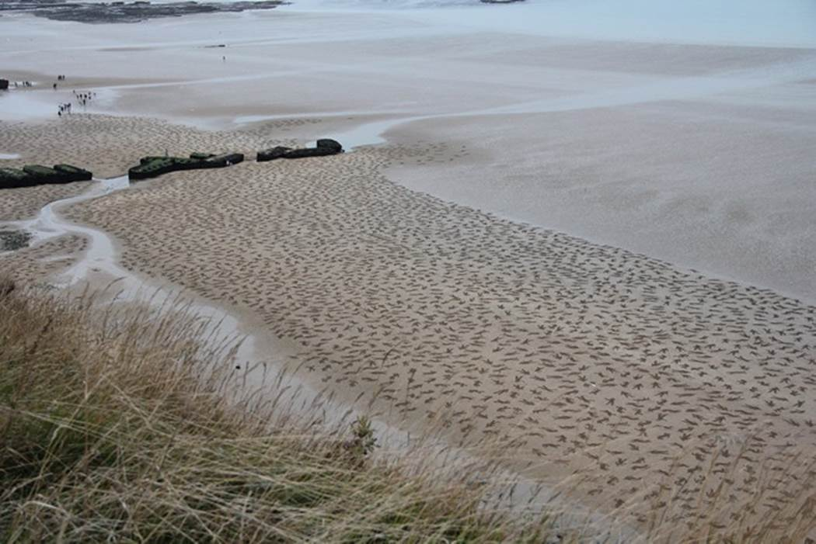
9,000 Fallen Soldiers Etched into the Sand on Normandy Beach to Commemorate Peace Day on September 25, 2013

Slide 2
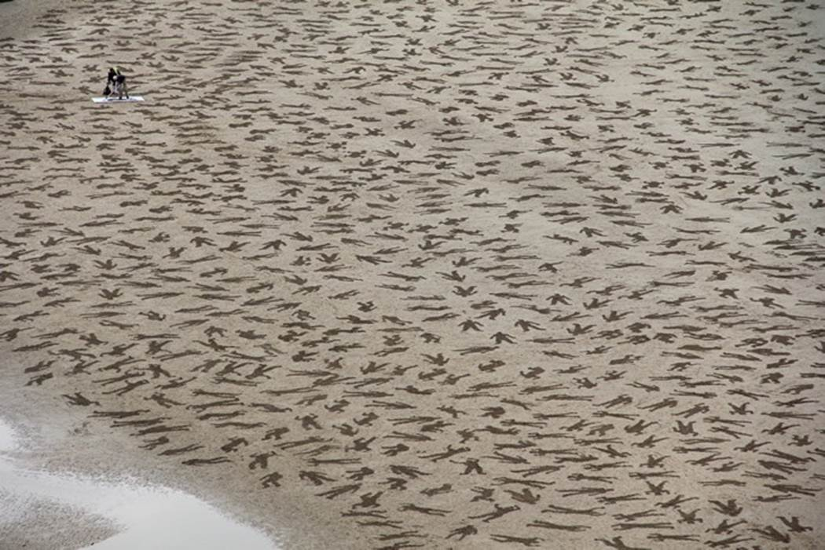

Slide 3
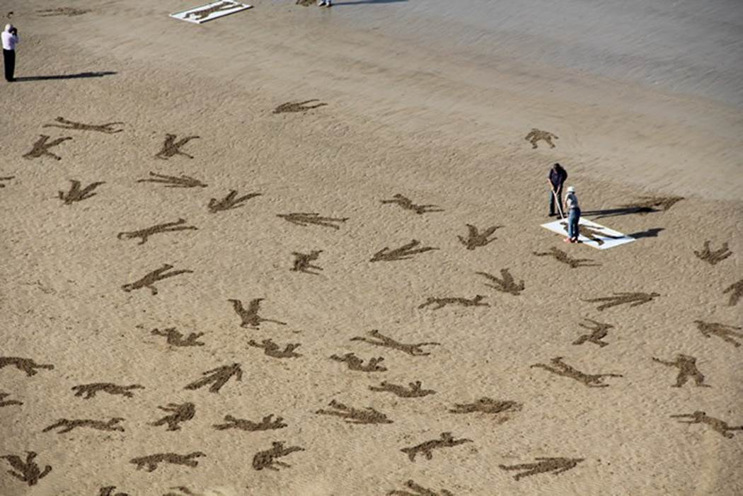

Slide 4
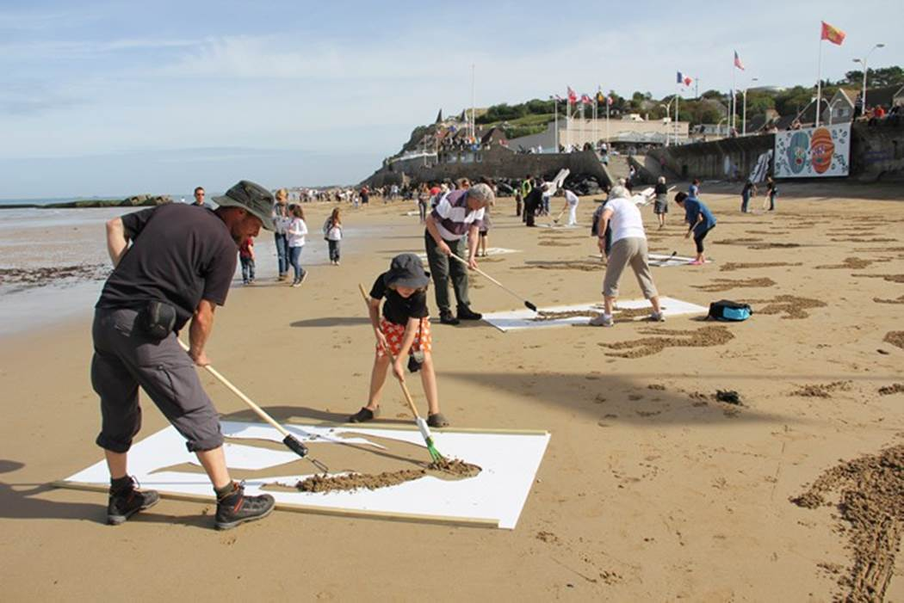

Slide 5
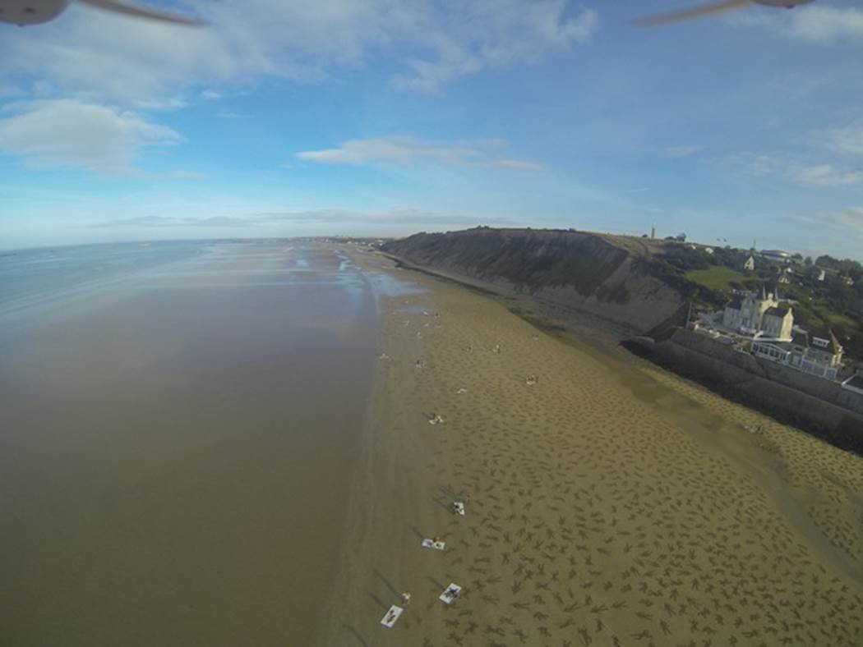

Slide 6
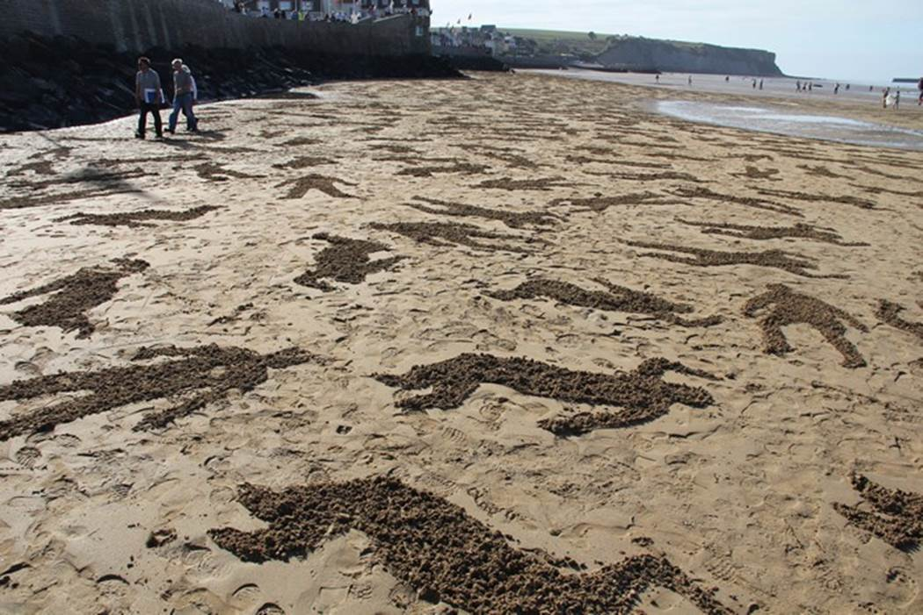

Slide 7
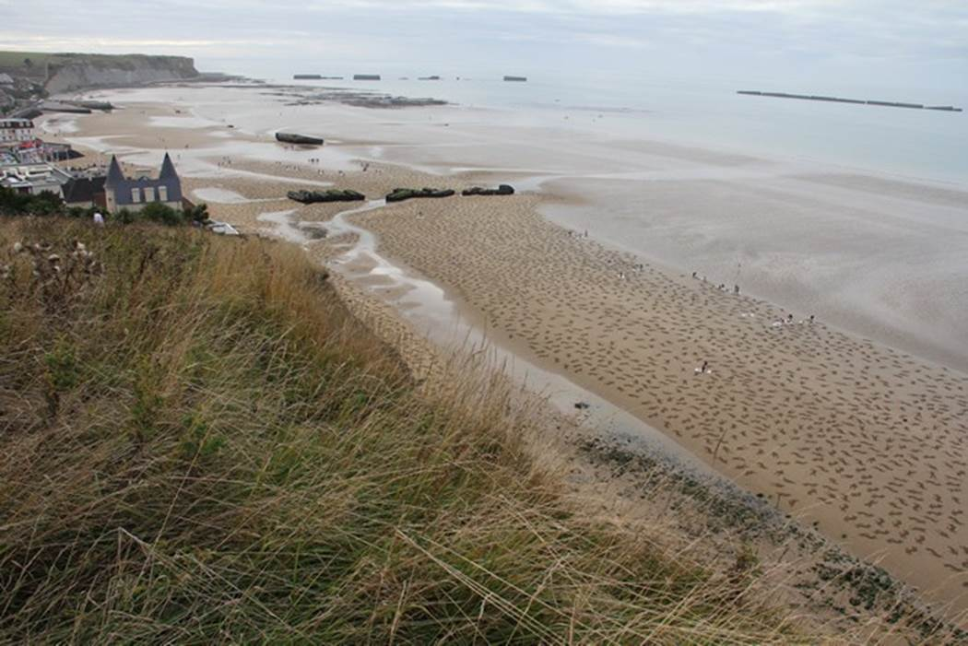

Slide 8
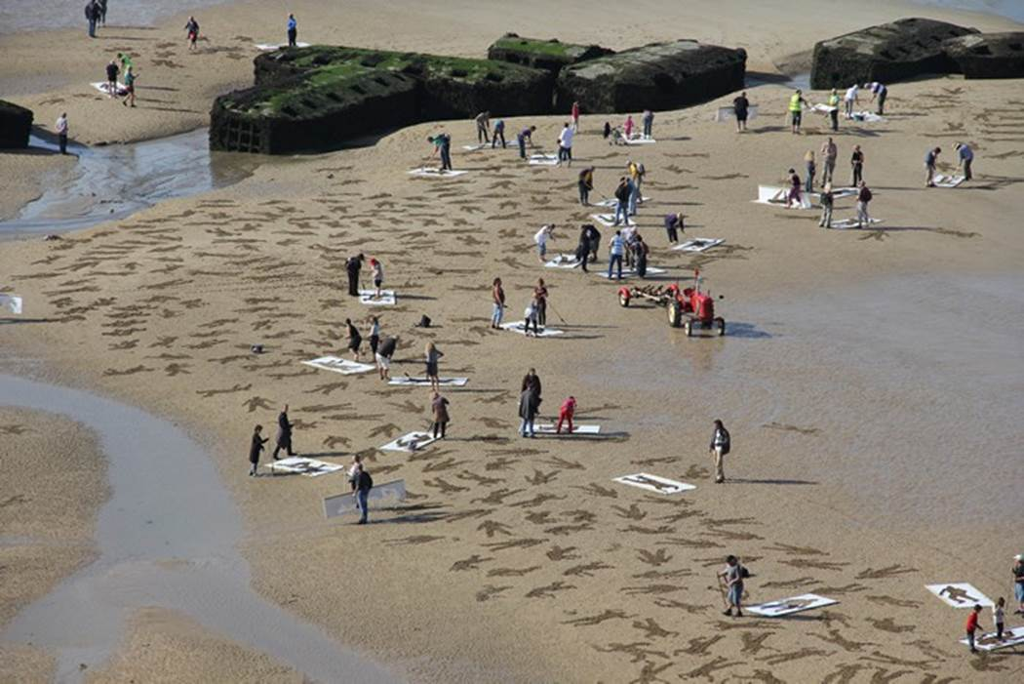

Slide 9
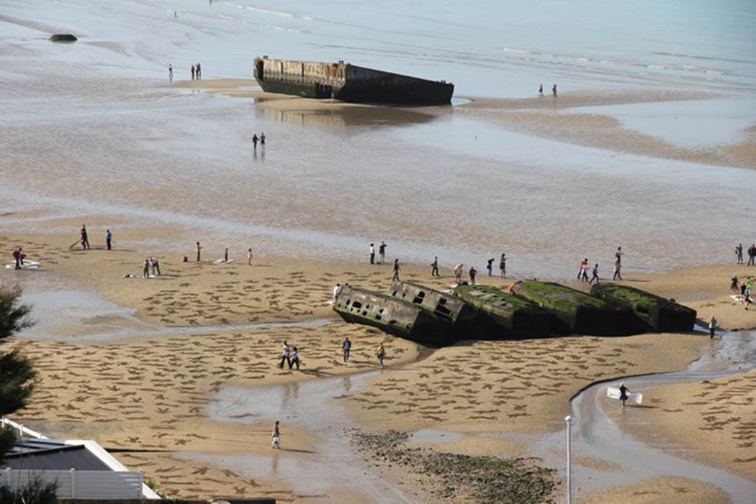

Slide 10
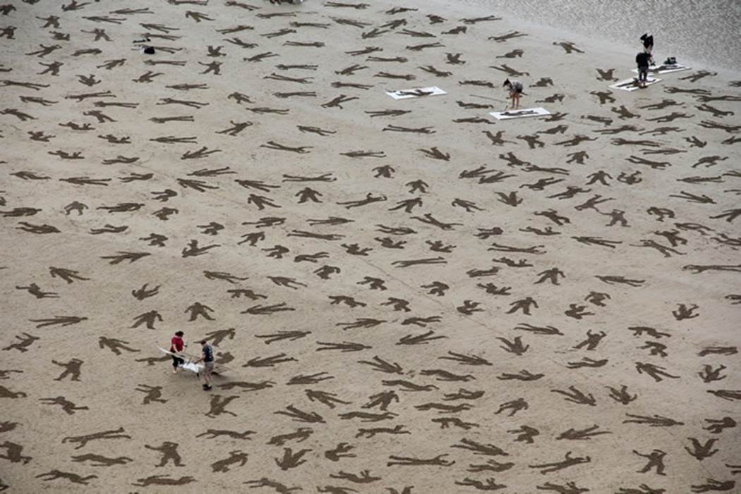

Slide 11
September 25th, 2013. British Artists Jamie Wardley and Andy Moss accompanied by numerous volunteers took to the beaches of Normandy with rakes and stencils in hand to etch 9,000 silhouettes representing fallen people ino the sand. Titled The Fallen 9000, The piece is meant as a stark visual reminder of the CIVILIANS, GERMANS and ALLIED FORCES who died during the D-Day beach landings at Arromanches on June 6th, 1944. during WWII. The original team consisted of 60 volunteers, but as word spread nearly 500 additional local residents arrived to help with the temporary installation that lasted only a few hours before being washed away by the tide.

